Slide 1
Platform Stacks Tiger Team
Email: platform-stacks@engage.digitaltwinconsortium.org
9th December 2020

Slide 2
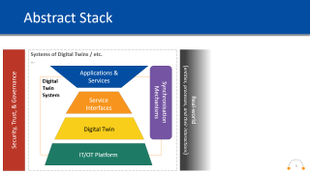
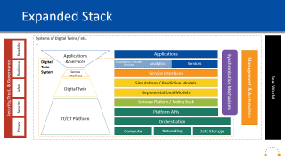
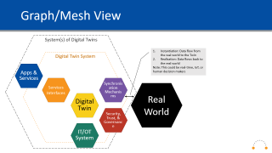
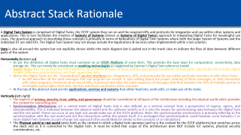
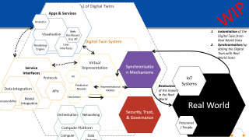
Outline
Abstract Stack
Rationale
Expanded Traditional Stack
Mesh View
Simplified
Expanded
Notes:
to Dan Isaacs - Digital Twin Consortium (privately): 4:03 PM
HI Dan, any particular objectives you'd like to see today? Or carry on as normal?
from Dan Isaacs - Digital Twin Consortium (privately): 4:06 PM
not at this point other than disuss the stack expanded in context of graph/mesh
from Dan Isaacs - Digital Twin Consortium to everyone: 4:24 PM
An API describes all the valid messages that one program can accept. It says nothing about the proper ordering of these messages, or their interaction with other programs.
Protocols sit on top of APIs. A protocol describes the valid sequence of messages that flow between the APIs of multiple parties to accomplish some higher-level task
from Dan Isaacs - Digital Twin Consortium (privately): 4:24 PM
Just put a description from the web on differences
from Dan Isaacs - Digital Twin Consortium (privately): 4:26 PM
so interesting points as i can see the opposite being true also
from Sean Olcott to everyone: 4:37 PM
In definition: A representational model is a digital model consisting of persisted information.
A simulation model is an executable digital model (of a process) consisting of reference data and computational algorithms which (when executed or “run”) take representational models as input and produce representational models as output.
from Sean Olcott to everyone: 4:38 PM
A representational model is a digital model consisting of persisted information.
A simulation model is an executable digital model (of a process) consisting of reference data and computational algorithms which (when executed or “run”) take representational models as input and produce representational models as output.
from Sean Olcott to everyone: 4:54 PM
In current draft of definition: To synchronize (in the context of a digital twin) means to cause the virtual representation to more-closely match the real-world or cause the real-world to more-closely match the virtual representation of a desired state.
Real-to-virtual synchronization is the process of mirroring the real world in the virtual representation.
Virtual-to-real synchronization is a process of mirroring the virtual representation into the real world.
A real-to-virtual synchronization mechanism is a means by which the virtual representation is synchronized with the real-world as a result of observations made of the real-world.
A virtual-to-real synchronization mechanism is a means by which the real world is changed to match an intended state depicted in the virtual representation.
Synchronization frequency is the frequency with which synchronization occurs.
Synchronizing fidelity is a characterization of the degree of detail and accuracy of the digital twin.
from Chafia Aouissi to everyone: 4:54 PM
I've to drop. Thank you everyone. Great discussions.

Slide 3
Abstract Stack
Security, Trust, & Governance
Systems of Digital Twins / etc.
…
Real-world
(entities, processes, and their interactions)
Applications &
Services
Synchronisation Mechanisms
Digital
Twin
System
Service Interfaces
Digital Twin
IT/OT Platform

Slide 4
Abstract Stack Rationale
A Digital Twin System is comprised of Digital Twins, the IT/OT system they run on and the required APIs and protocols for integration and use within other systems and applications. This in turn facilitates the creation of Systems of Systems (shown as Systems of Digital Twins) approach to integrating Digital Twins for meaningful use cases. The practical approach to describing these concepts is primarily in terms of federations of Digital Twin Systems where both the larger System of Systems and the individual DT are valid DTs. The Digital Twin System may not always include the Applications & Services when implemented within a SoS solution.
Data is also all around the system but not explicitly shown within the stack diagram but is pulled out in the mesh view to indicate the flow of data between different parts of the system.
Horizontally (bottom up)
As per the definition all Digital Twins must run/exist on an IT/OT Platform of some form. This provides the base layer for computation, connectivity, data storage etc. This can mostly be considered as enabling technologies as suggested by Gartner’s Digital Twin reference model
Digital Twins then run on/use that IT/OT platform, this includes all types of twins and the appropriate breakdown of their parts. Specifically this includes digital models (reference and simulation) and their supporting data
Above the Digital Twins are the “standardised” service interfaces (i.e. integrations, APIs, and protocols) for use within particular domains or with other Twins.
An API describes all the valid messages that one program can accept. It says nothing about the proper ordering of these messages, or their interaction with other programs. Protocols sit on top of APIs. A protocol describes the valid sequence of messages that flow between the APIs of multiple parties to accomplish some higher-level task. Services interfaces summarise these concepts.
At the top of the abstract stack are the applications, services and systems that either feed into, work with, or make use of the twins
Vertically (left-right)
The aspects of privacy, security, trust, safety, and governance should be considered at all layers of the architecture including the physical world which provides the context for everything else
Synchronisation Mechanisms are a central tenet of Digital Twins and is also defined as a vertical concept from a perspective of ingress, egress, and interoperability. This is indicated between the physical world and the software world’s as it is also the means for synchronising data between the Digital Twin and the real world. These can occur at any layer but would make use of the IT/OT platform. Note: the synchronisation mechanisms is primarily referring to the synchronisation with the real world and not the interactions within the system itself. It is envisaged that synchronisation could however occur between 2 or more Digital Twin Systems as part of large SoS approach (this would likely be similar to the concepts of co-simulation).
The Physical world or real world exists both as the context in which a digital twin operates (and so is the context for the IT/OT platforms) but stretches across the stack and as it is connected to the Digital Twin. It must be noted that scope of this architecture does NOT include IoT systems, physical security considerations, etc.

Slide 5
Expanded Stack
Systems of Digital Twins / etc.
…
Security, Trust, & Governance
Real World
Privacy
Applications
& Services
Applications
Synchronisation Mechanisms
Digital
Twin
System
Visualisation / Render Services
Analytics
Services
Security
Service Interfaces
Service Interfaces
Digital Twin
Digital Twin Interaction/Integration Functions
Management & Automation
Safety
Computational Simulation Models
Digital Representational Models
Resilience
IT/OT Platform
Software Platform / Tooling Stack
Platform APIs
Reliability
Orchestration
Compute
Networking
Data Storage

Slide 6
Expanded Stack Rationale
The IT/OT platform consists of 5 primary elements:
Compute
Networking including Communication and Connectivity
Data storage (e.g. databases, warehousing)
Orchestration, and the required software applications
There is also often an API layer for managing the IT/OT platform
The software applications themselves sit between the IT/OT layer and the Digital Twin as they are often specific to a modelling or simulation tool and within a given domain
Digital Twins are then separated into:
Representational models and functional simulations (these could also be described as predictive or computational models)
Digital Twin Interaction/Integration Functions provide a framework to combine various types of digital twins in an integrated digital world and an unified layer to expose Service Interfaces
The Service Interfaces are an opportunity to begin to define a level of standardisation for interoperability between Digital Twin Systems but currently would be specific to a given technology stack or domain.
Application Services include visualisation/rendering services as well as analytics
Applications will be driven by case studies
The Security & Trustworthiness vertical block is split as per the IIC guidance into 5 sub-blocks: privacy, security, safety, resilience, and reliability
Synchronisation Mechanisms as previously defined this is to facilitate the integration with the real world and specifically the incorporation of real-world data into the Digital Twin and realise the effects of the Digital Twin on the real-world
Management & Automation will include both the business processes as well as the technologies for managing the entire stack. This is likely to initially be specific to a given domain but is particularly important when considering a SoS approach. The various lifecycles (both domain specific and that of the Digital Twin itself) will define the structure.
Notes:
Note: I’ve not included the concept of “assurance” as it should be encapsulated by the other 5

Slide 7
Mesh Perspective
Service Interfaces
Applications & Services
Data Integration
Protocols
Rendering
Analytics
Model / Simulation Interoperability
Model Integration
User Interfaces
Visualisation
Synchronisation Mechanisms
Security, Trust, & Governance
Management & Automation
Real → Virtual
Virtual → Real
Digital Twin
IT / OT Platform
Integration Functions
Interaction Functions
Orchestration
Platform APIs
Software Platform / Tooling Stack
Digital Representations
Computational Simulation
Compute
Networking
Data Storage

